Slide 1
Lamb shift from experiment to theory (from QM to Dirac and finally QFT description of the Lamb shift)

Slide 2
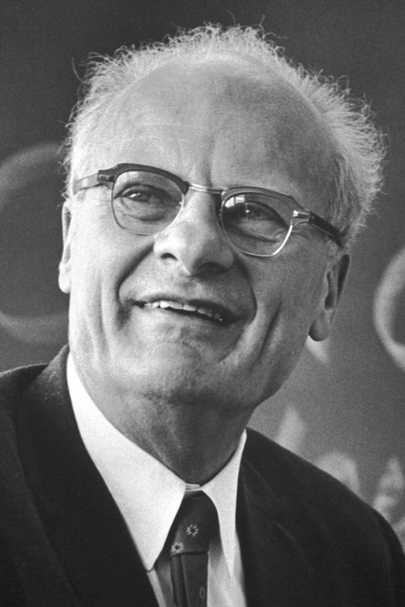
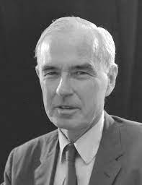


Willis Lamb
Robert C. Retherford
Hans Bethe
1955 for his discoveries concerning the fine structure of the hydrogen spectrum
He was a graduate student of W. Lamb at Columbia Radiation Laboratory.
1976 for Stellar nucleosynthesis
1913-2008
1912-1981
1906-2005

Slide 3
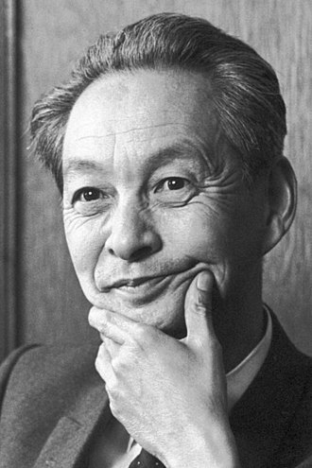
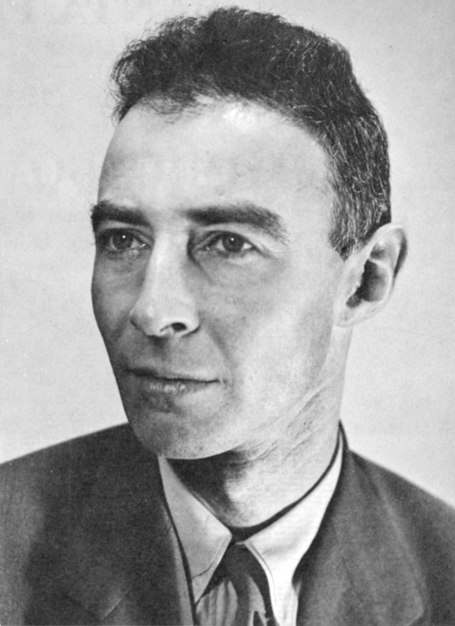
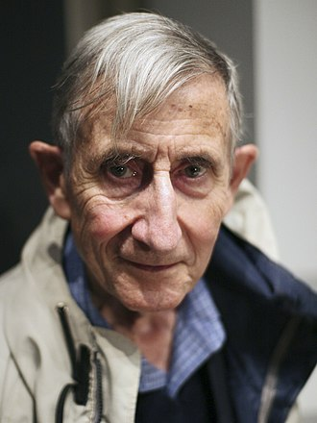
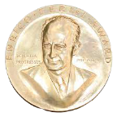
Shin'ichirō Tomonaga
Sin-Itiro Tomonaga
Freeman Dyson
J. Robert Oppenheimer
Heineman Prize (1965)
Lorentz Medal (1966)
Hughes Medal (1968)
Harvey Prize (1977)
Wolf Prize (1981)
Andrew Gemant Award (1988)
Matteucci Medal (1989)
Oersted Medal (1991)
Enrico Fermi Award (1993)
Templeton Prize (2000)
Pomeranchuk Prize (2003)
Henri Poincaré Prize (2012)
1965 with Feynman and Schwinger for discovery of renormalization method
President J.Kennedy awarded him Fermi medal.
1906-1979
1904-1967
1923-2020

Slide 4
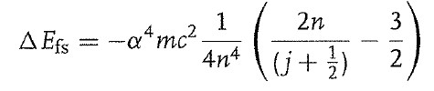
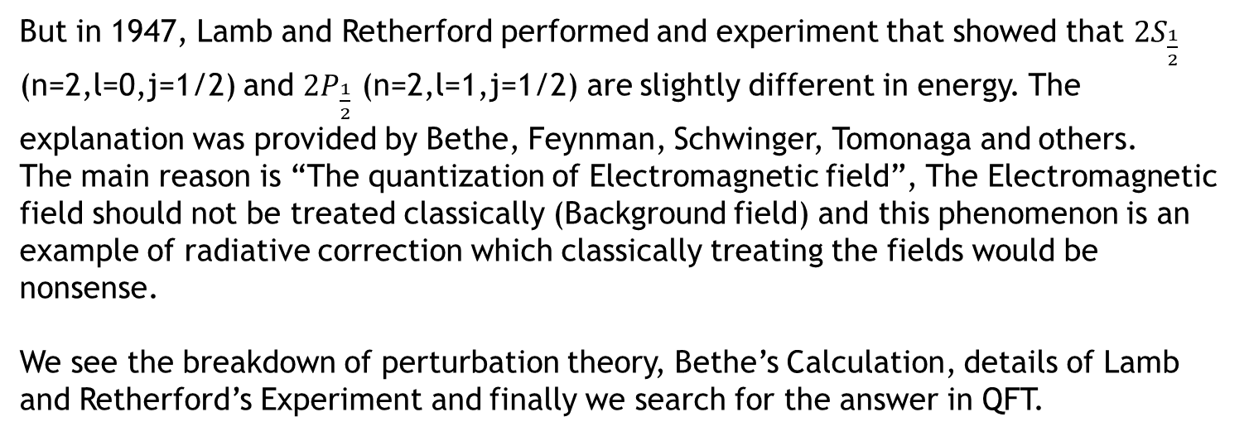
A brief introduction to the Lamb shift effect
From the fine structure of hydrogen(like) atom we know that the states with different l (quantum number) would share the same energy.
But in 1947, Lamb and Retherford performed and experiment that showed that $2S_{\frac{1}{2}}$ (n=2,l=0,j=1/2) and $2P_{\frac{1}{2}}$ (n=2,l=1,j=1/2) are slightly different in energy. The explanation was provided by Bethe, Feynman, Schwinger, Tomonaga and others.
The main reason is “The quantization of Electromagnetic field”, The Electromagnetic field should not be treated classically (Background field) and this phenomenon is an example of radiative correction which classically treating the fields would be nonsense.
We see the breakdown of perturbation theory, Bethe’s Calculation, details of Lamb and Retherford’s Experiment and finally we search for the answer in QFT.

Slide 5

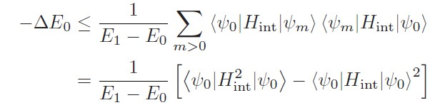
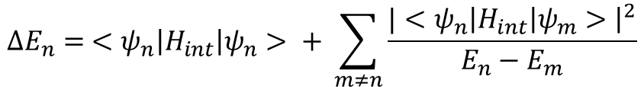
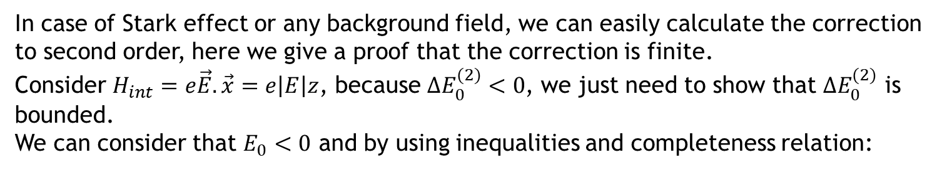
Why QM fails to describe Lamb shift?
We use perturbation theory in order to calculate change of energy in the presence of $H_{int}$ which is not time-dependent.
$$ΔE_{n}= <ψ_{n}\left|H_{int}\right|ψ_{n}> + \sum_{m≠n}{\frac{|<ψ_{n}\left|H_{int}\right|ψ_{m}>{\left.​\right|}^{2}}{E_{n}−E_{m}}}$$
In case of Stark effect or any background field, we can easily calculate the correction to second order, here we give a proof that the correction is finite.
Consider $H_{int}=e\vec{E}.\vec{x}=e\left|E\right|z$, because $ΔE_{0}^{(2)}<0$, we just need to show that $ΔE_{0}^{(2)}$ is bounded.
We can consider that $E_{0}<0$ and by using inequalities and completeness relation:

Slide 6

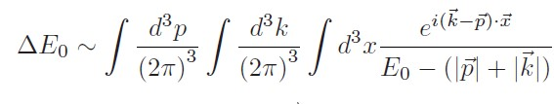
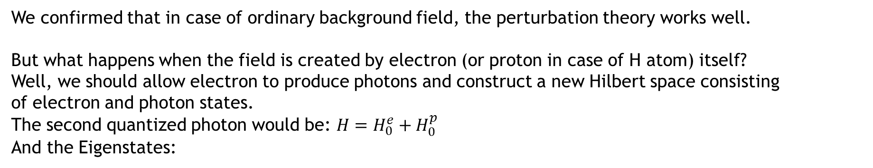
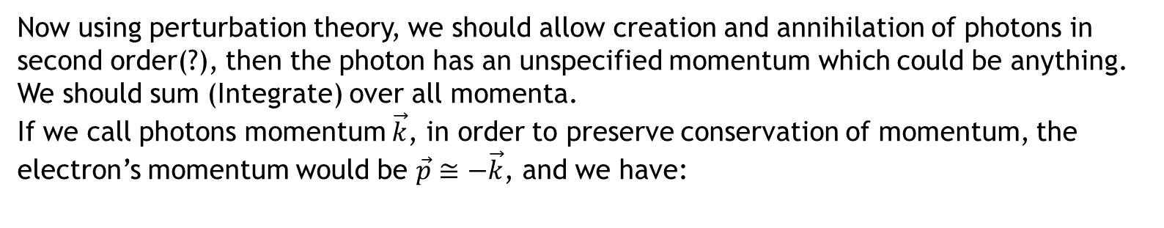
Why QM fails to describe Lamb shift?
We confirmed that in case of ordinary background field, the perturbation theory works well.
But what happens when the field is created by electron (or proton in case of H atom) itself?
Well, we should allow electron to produce photons and construct a new Hilbert space consisting
of electron and photon states.
The second quantized photon would be: $H=H_{0}^{e}+H_{0}^{p}$
And the Eigenstates:
Now using perturbation theory, we should allow creation and annihilation of photons in second order(?), then the photon has an unspecified momentum which could be anything. We should sum (Integrate) over all momenta.
If we call photons momentum $\vec{k}$, in order to preserve conservation of momentum, the electron’s momentum would be $\vec{p}≅−\vec{k}$, and we have:

Slide 7

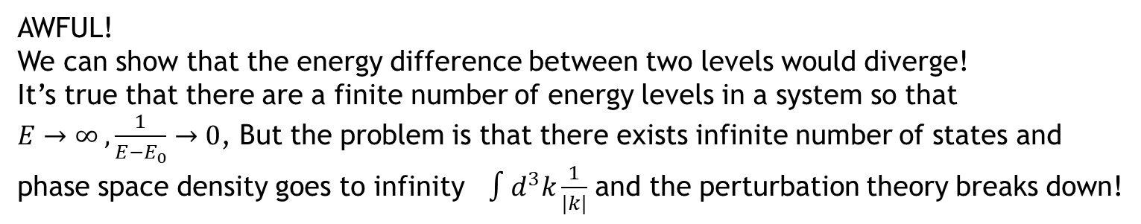
Why QM fails to describe Lamb shift?
Performing p and x integrations we would see something like:
AWFUL!
We can show that the energy difference between two levels would diverge!
It’s true that there are a finite number of energy levels in a system so that
$E→∞ ,\frac{1}{E−E_{0}}→0$, But the problem is that there exists infinite number of states and phase space density goes to infinity $∫d^{3}k\frac{1}{|k|}$ and the perturbation theory breaks down!

Slide 8
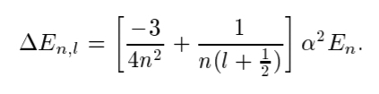
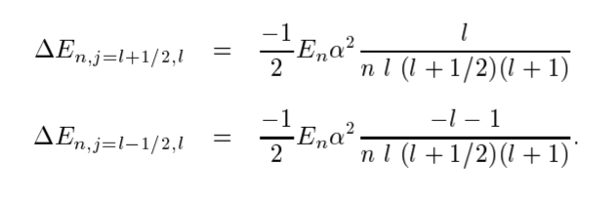
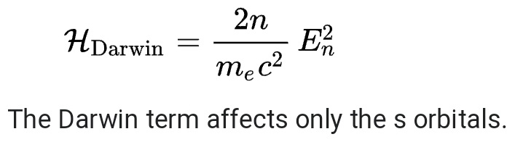
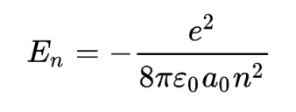
How to observe the fine structure in the lab
A short review
Relativistic correction
Spin-Orbit coupling
Non-relativistic expansion of the Dirac equation

Slide 9
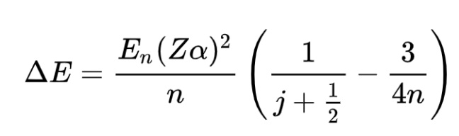

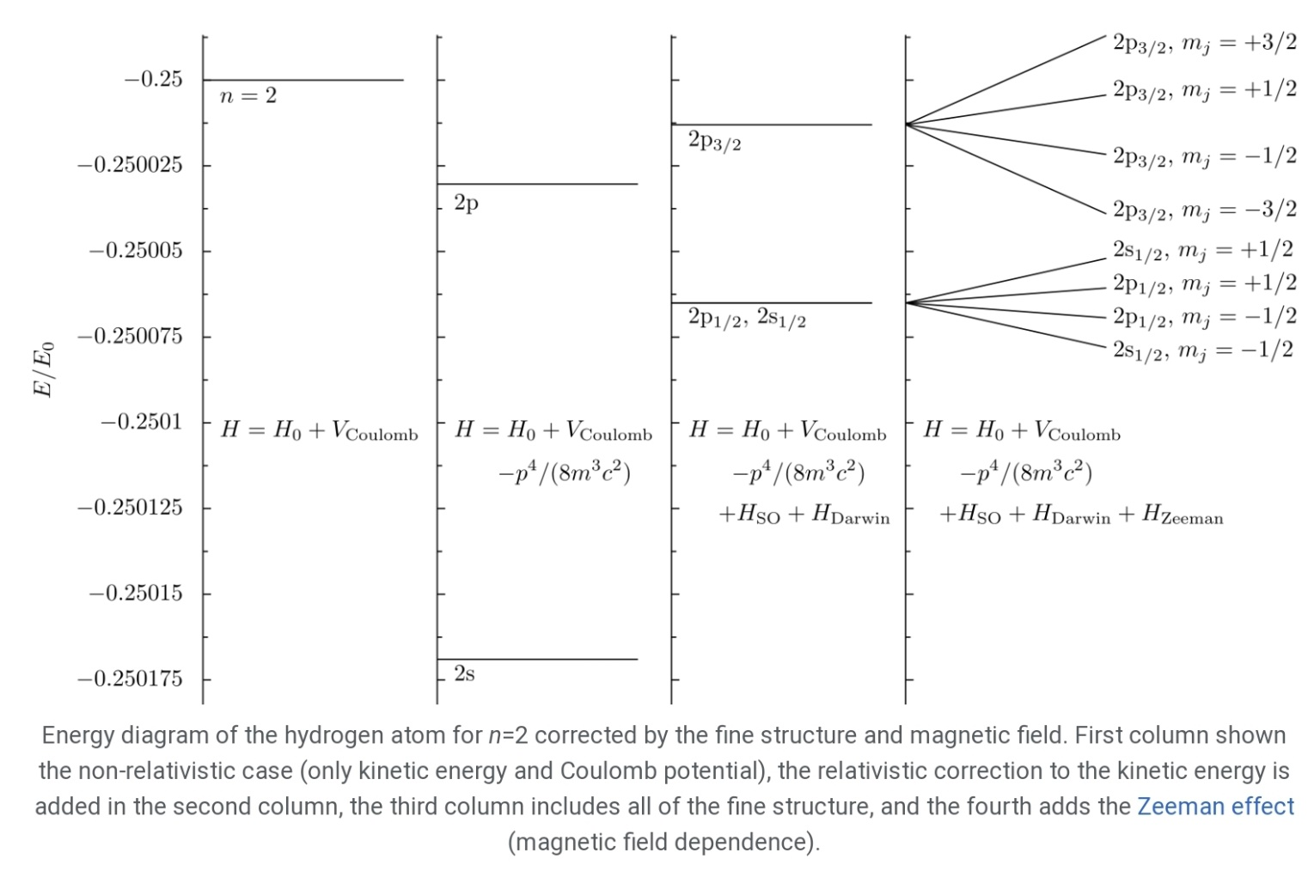
How to observe the fine structure in the lab
A short review

Slide 10
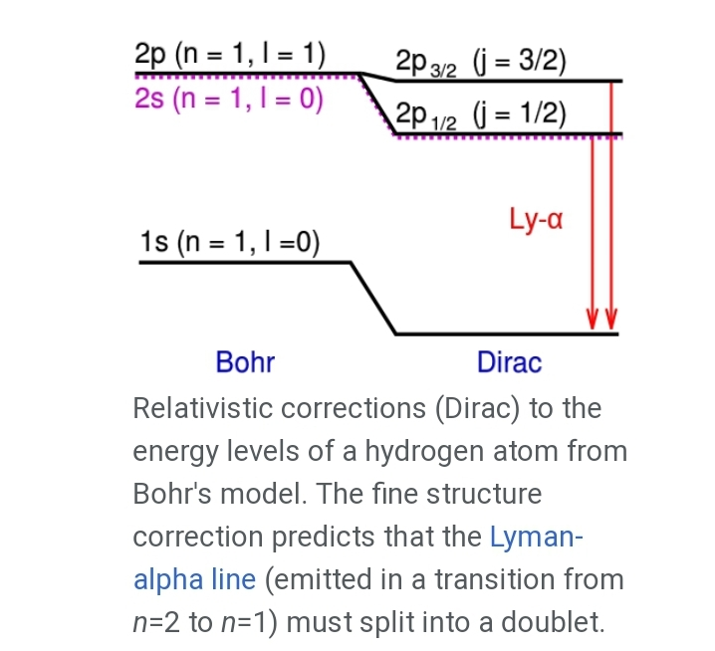
How to observe the fine structure in the lab
A short review

Slide 11
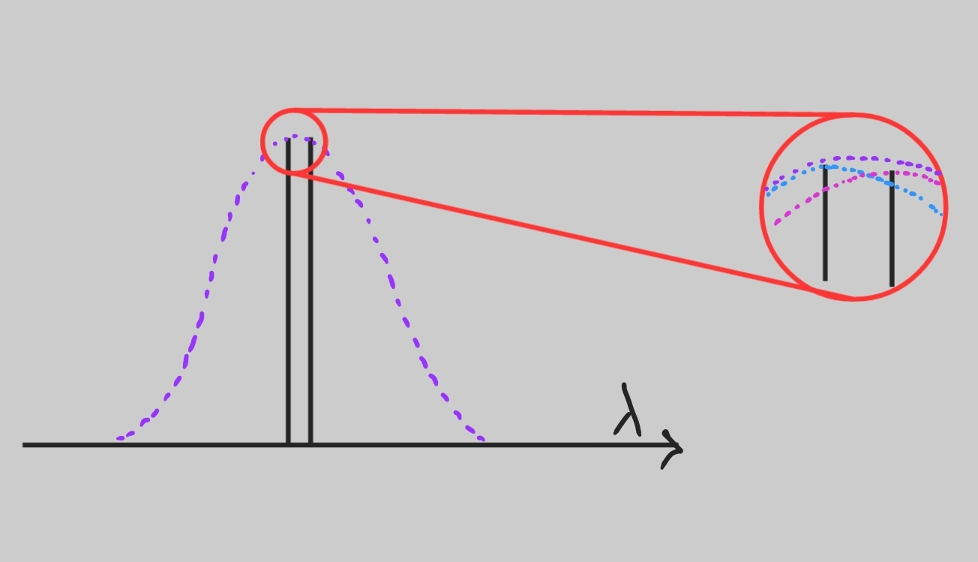
How to observe the fine structure in the lab
The Doppler effect as a major obstacle to observing the level splitting in the study of Balmer lines:

Slide 12
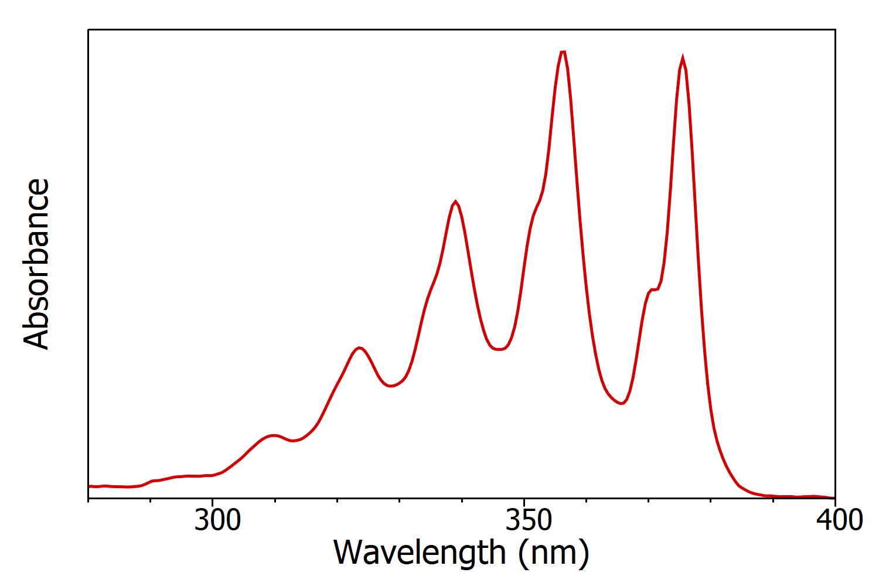
How to observe the fine structure in the lab
Also detect the direct absorption is exceedingly difficult.

Slide 13
How to observe the fine structure in the lab
The solution:
The 2S state in the absence of external electric fields is metastable but 2P state is non-metastable.

Slide 14
How to observe the fine structure in the lab
The solution:
“The metastability is very much reduced in the presence of external electric fields owning to Stark effect mixing of the S and P levels with resultant rapid decay of the combined state”.
“If for any reason [the Zeeman splitting of the levels in an external magnetic field] the level does not exactly coincide with the level, the vulnerability of the state to external fields will be reduced”.

Slide 15
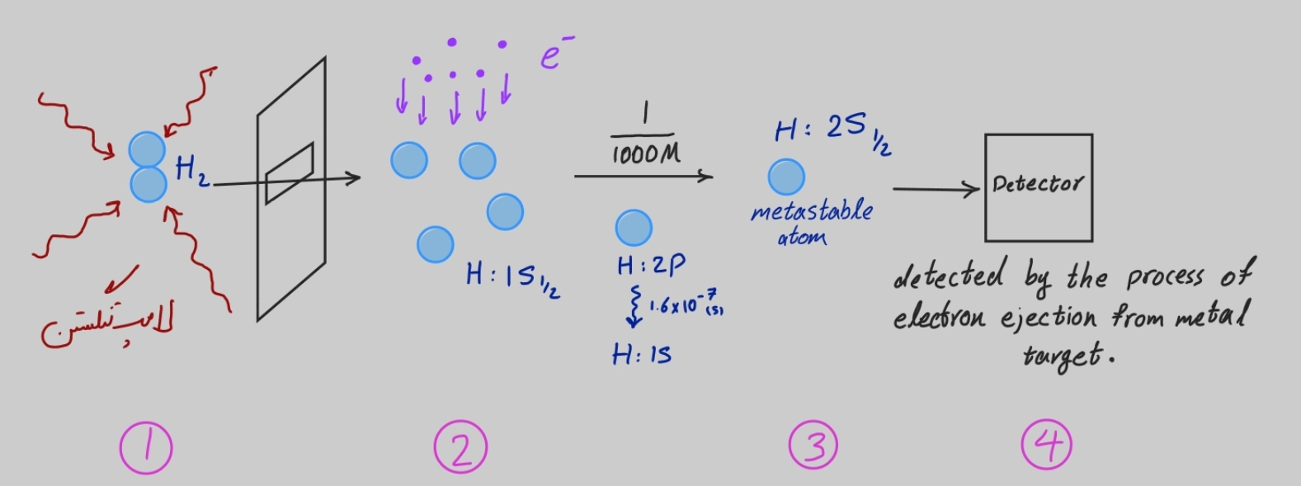
How to observe the fine structure in the lab
The solution:

Slide 16
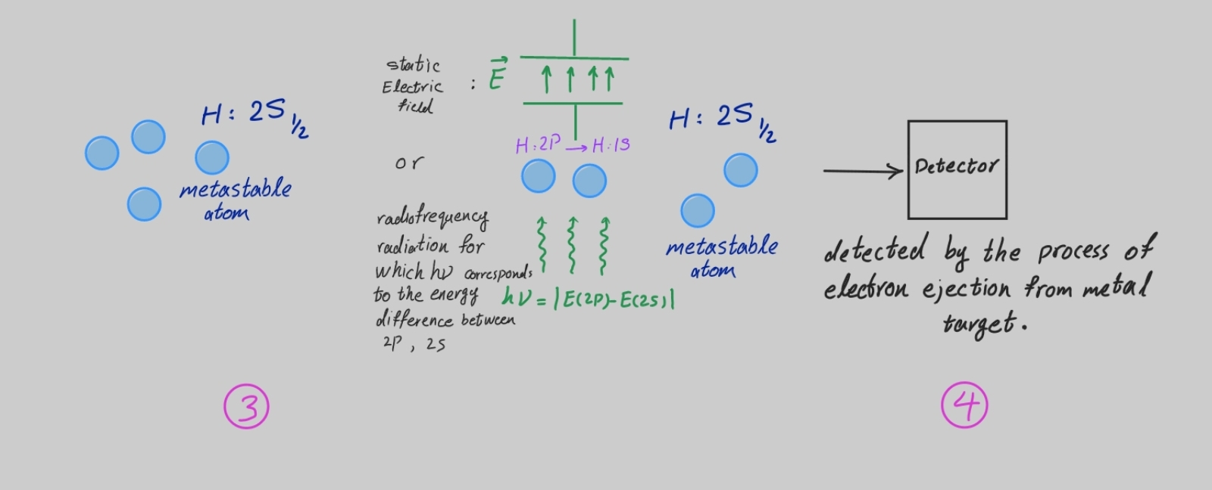
How to observe the fine structure in the lab
The solution:
If, between stages 3 and 4, due to an external electric field or radiofrequency radiation, metastable atoms transmit to any of the 2P levels, they will decay and as a result, the current measured by the detector will decrease because the detector is not sensitive to atoms in the ground state.

Slide 17
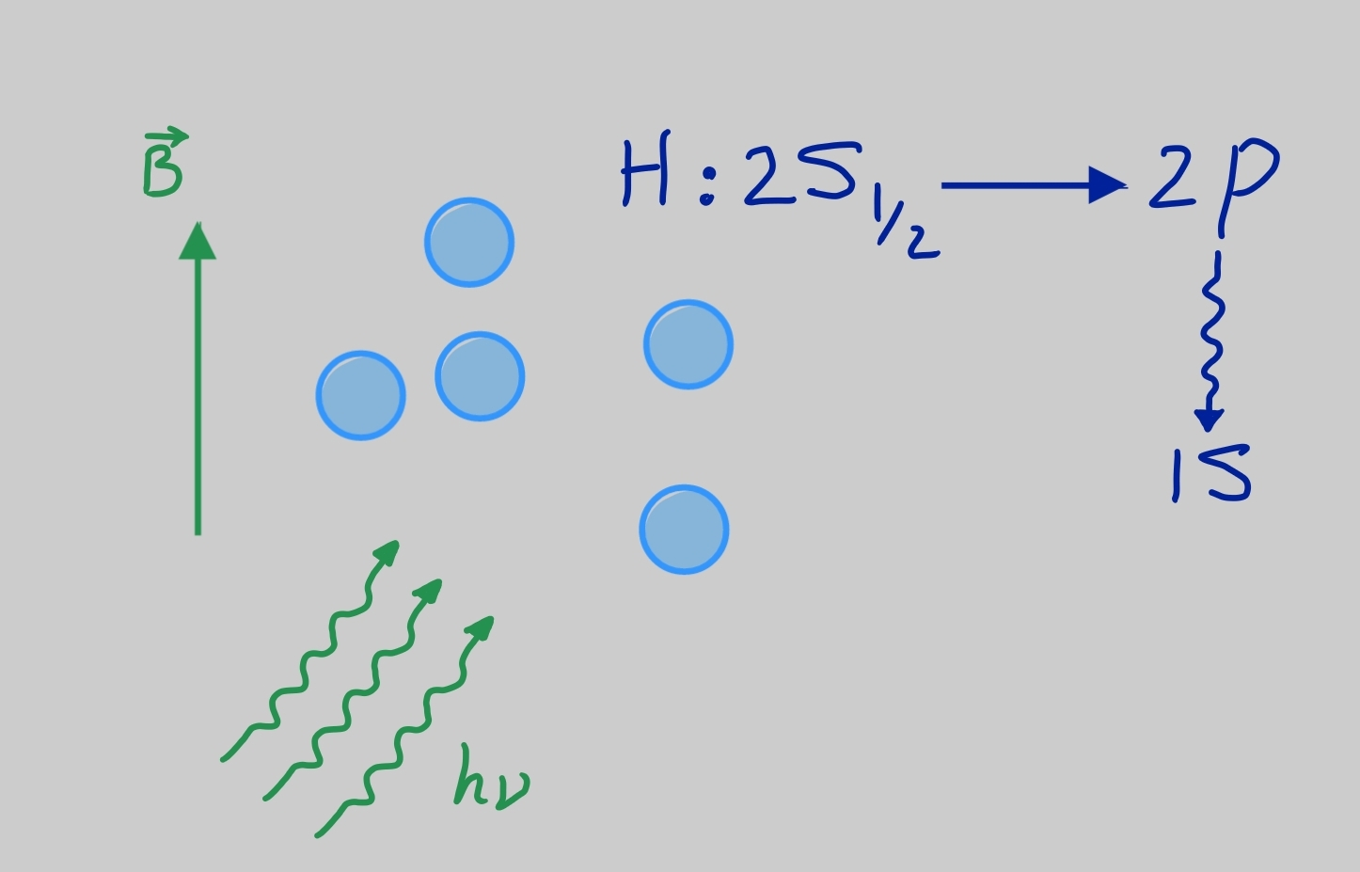
How to observe the fine structure in the lab
The solution:

Slide 18
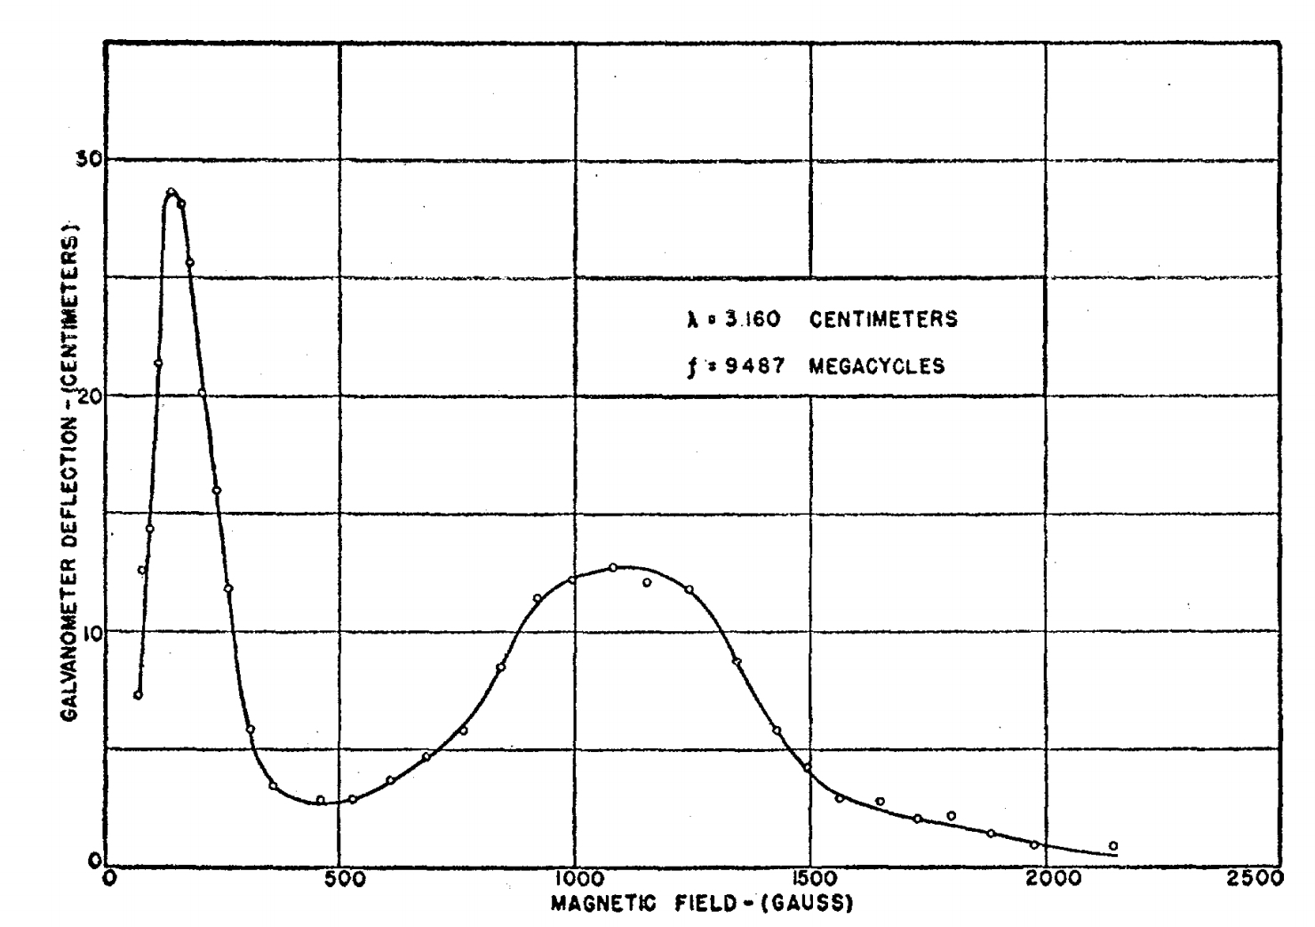
How to observe the fine structure in the lab
The solution:

Slide 19
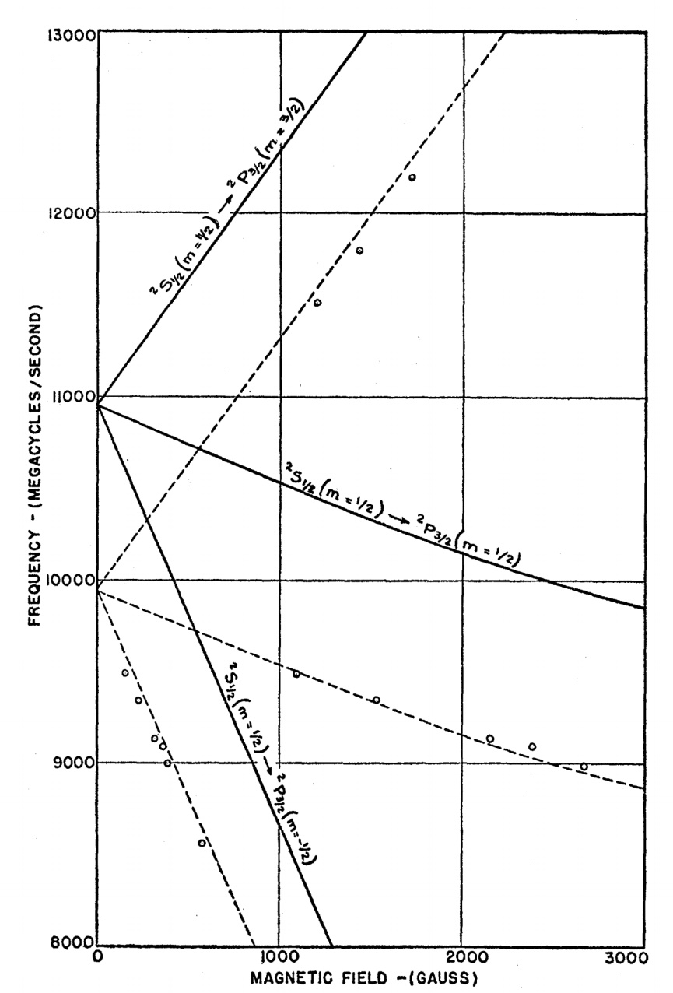
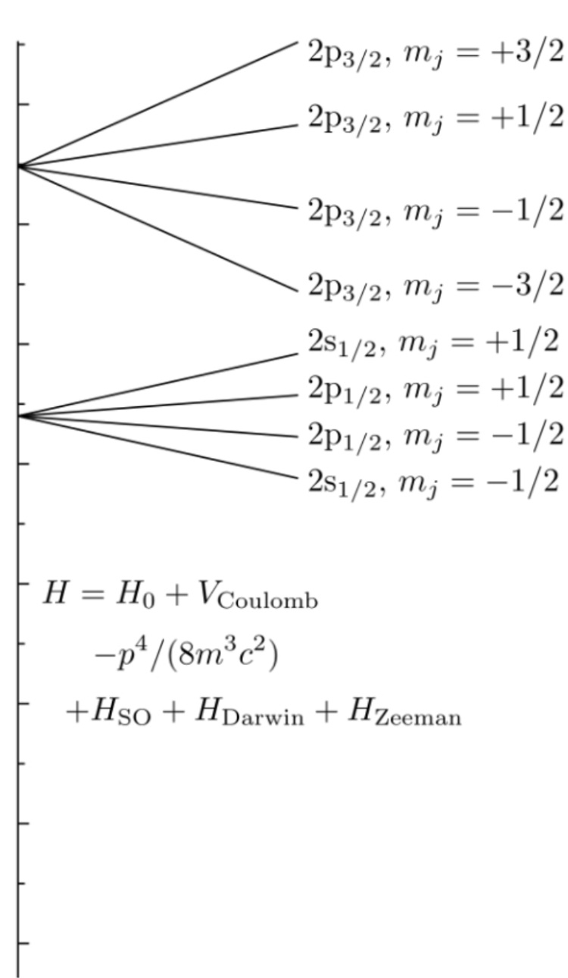
How to observe the fine structure in the lab
The solution:

Slide 20
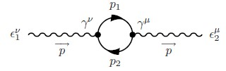
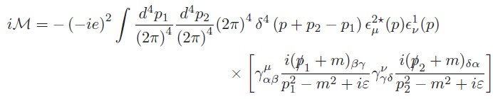
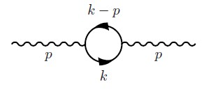


QFT description of the Lamb shift
We just claim that one-loop correction to tree level amplitudes would give the correction to potential and finally we can recover the Lamb shift in this way.
Consider the following diagram:
According to Spinor QED Feynman rules we can write:
Notice that Tr reveals naturally and by substituting $p_{2}^{μ}→k^{μ}$, we can easily find:
(I’ve dropped the polarizations too)
Fermionic Loop
Order of Interaction
Propagator
The remaining part in trace

Slide 21
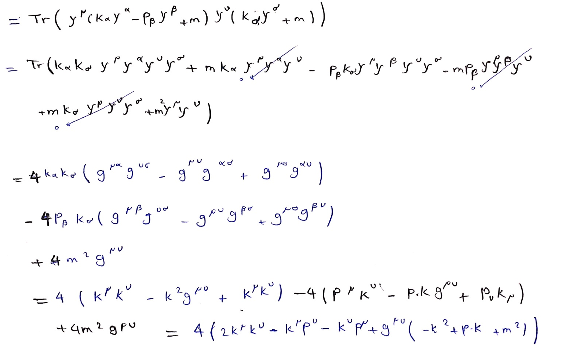

QFT description of the Lamb shift
Lets do a little calculation and work out the Tr (using trace identities in appendix I) :
Attention: Whole the calculations of this diagram are either tricky or rough to do!
We put this back in the amplitude relation in the previous chapter and by defining a new quantity we will have:

Slide 22



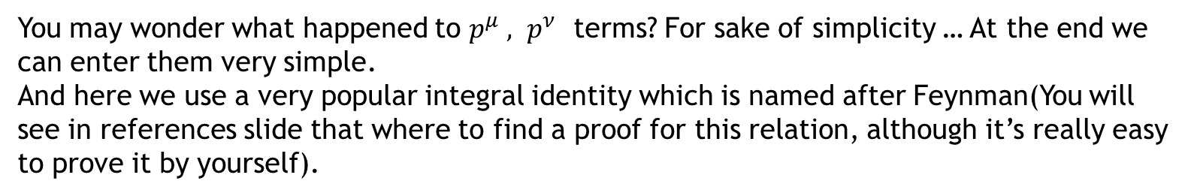
QFT description of the Lamb shift
You may wonder what happened to $p^{μ} , p^{ν}$ terms? For sake of simplicity … At the end we can enter them very simple.
And here we use a very popular integral identity which is named after Feynman(You will see in references slide that where to find a proof for this relation, although it’s really easy to prove it by yourself).
Exploiting this result with $A={\left(p−k\right)}^{2}−m^{2}$ and $B=k^{2}−m^{2}$ we would have:
And if we substitute $k^{μ}→k^{μ}+p^{μ}(1−x)$ we have:
And now we should evaluate this integral … Seems to be hard.

Slide 23

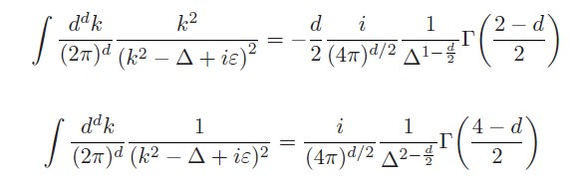
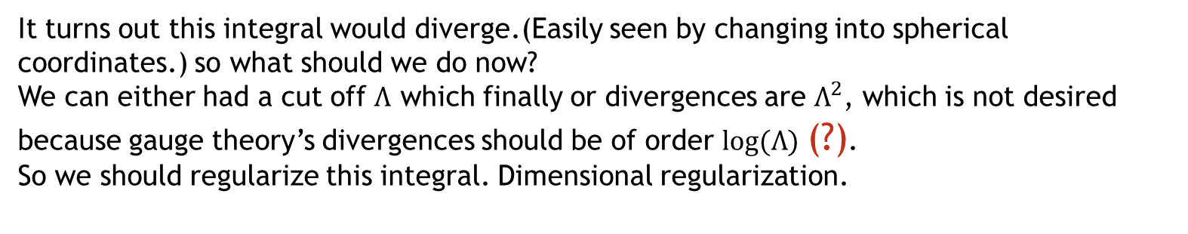
QFT description of the Lamb shift
Attention: Technicality Ahead.
It turns out this integral would diverge.(Easily seen by changing into spherical coordinates.) so what should we do now?
We can either had a cut off $Λ$ which finally or divergences are $Λ^{2}$, which is not desired because gauge theory’s divergences should be of order $log⁡(Λ)$ (?).
So we should regularize this integral. Dimensional regularization.
For finding the method of regularizing, see references slide.
And now this integral becomes finite and we can evaluate it.
This kind of integral are frequently seen in field theory and we have some formula for evaluating them.(See proof in references)

Slide 24
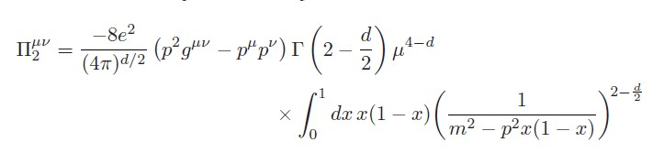
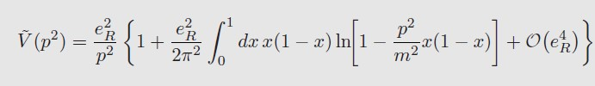

QFT description of the Lamb shift
And now is time to enter $p^{μ} , p^{ν}$ terms, which will be easy if we follow same procedure.
Here on, we calculated this diagram, and we can relate this contribution to propagator which is in touch with Fourier transform of potential … I do not enter into the details.
But you can see reference for details in references slide.
The reformed potential would be.
And we should do some approximation for $p^{2}≪m$

Slide 25


QFT description of the Lamb shift
And FINALLY, the reformed potential in Fourier space is:
Or in position space:
The Dirac delta function is takes all the responsibility for Lamb Shift.
Now we can use perturbation theory to evaluate energy differences between states.
Because S-orbital have no factor $r$ in wave function, so this new potential would affect them and causes a change in energy between S and P orbital … same as Lamb shift.

Slide 26
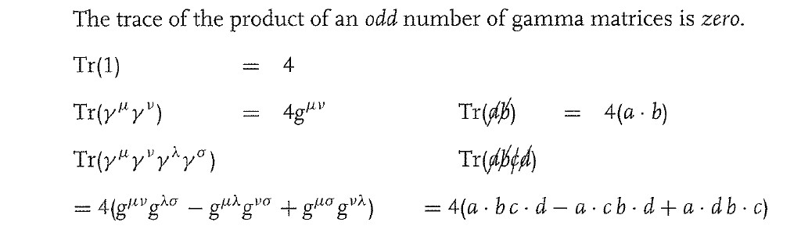
Appendix I. Trace Identities of Dirac gamma matrices
The following identities are crucial in calculating amplitudes which we used it a lot:

Slide 27
References for further reading and proof of theorems
Feynman integral relation: QFT and the standard model by Schwartz – Appendix B – B.1.2
Regularizing Method: QFT and the standard model by Schwartz – Appendix B – B.3
Integrals reference: QFT and the standard model by Schwartz – Appendix B – B.3.2

